Slide 1
Topics of this course
What is CS ?
Lect 1: what is computer
Lect 2: how is computer system working
Lect 3: Turing machine & P vs NP
Lect 4: computational thinking & algorithm
Lect 5: cloud computing
Why is CS so hot ?
Lect 6: introduction to machine learning and AI
Lect 7: introduction to big data
Lect 8: introduction to alphaFold/alphaFold2
How to learn CS ?

Slide 2
Introduction to ML/AI
qiang@suda.edu.cn

Slide 3
2014高考前的热帖
“(恢复)高考37年来，英语听力中男生邀请女生外出44次，女答应0次。女生邀请男生外出17次，男人答应17次。”
这推出一种考试蒙题技巧：如果是男女互邀，如果你没有太听懂题目的每一个词，那么，凡是女邀男，一律回答yes；反之回答no。

Slide 4
男女互邀背后的机器学习
实际上，上述技巧是机器学习中分类方法的一种简单应用。
当然，类似的机器学习方法的成功应用需要一定的前提，例如，大量的实例数据。
所以，严格来讲，上述解决方案不一定成立的。只是没有办法下的选择。

Slide 5
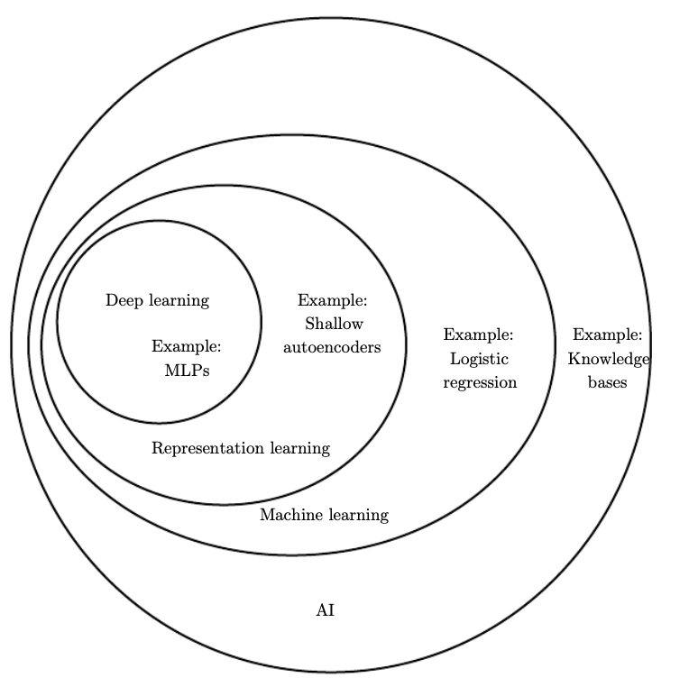
AI/ML/DL

Slide 6
What is ML
“it gives computers the ability to learn without being explicitly programmed”.
Arthur Samuel ,1959
“A computer program is said to learn from experience E with respect to some task T and some performance measure P, if its performance on T, as measured by P, improves with experience E. ”
Tom Mitchell, 1997

Slide 7
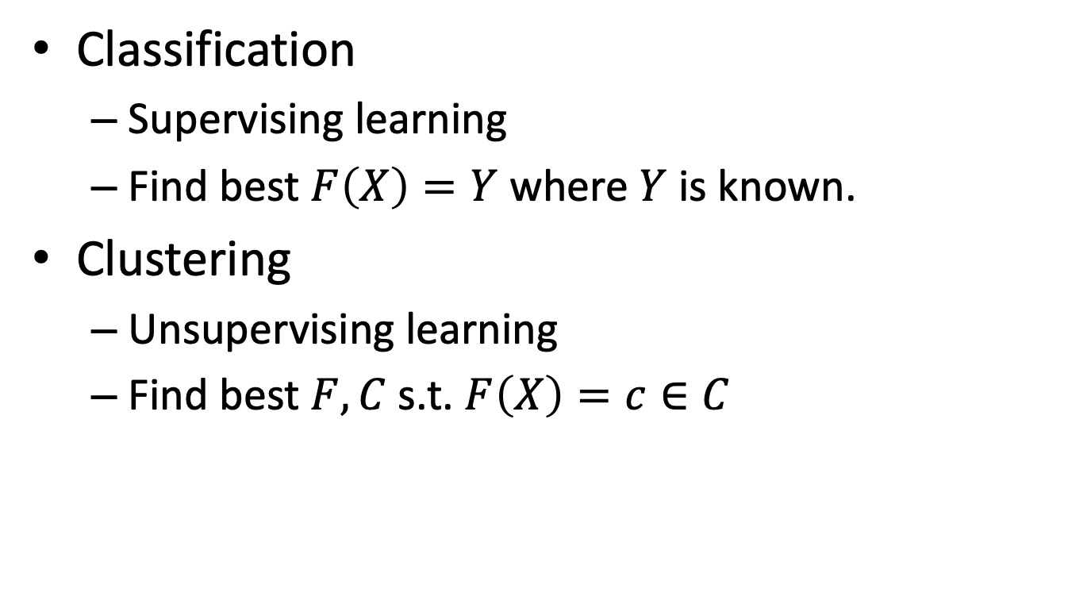
Typical tasks of ML
Classification
Supervising learning
Find best $F\left(X\right)=Y$ where $Y$ is known.
Clustering
Unsupervising learning
Find best $F,C$ s.t. $F\left(X\right)=c∈C$

Slide 8

How to get apple out of but without breaking the circle?

Slide 9
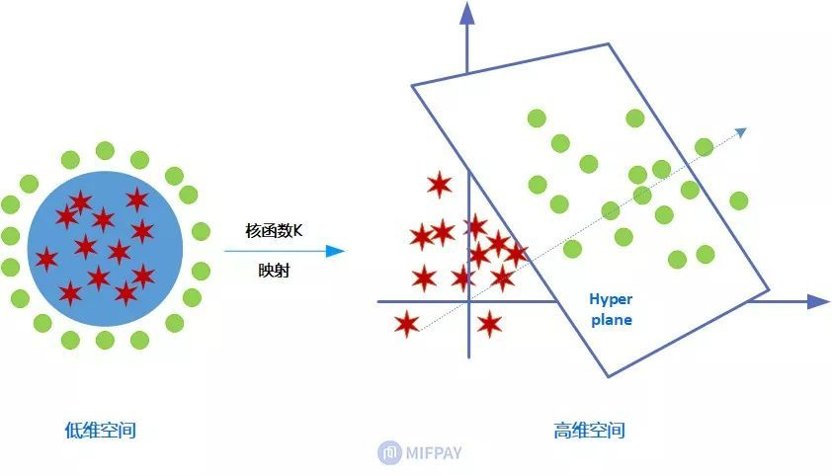
Classic (shallow) ML: SVM

Slide 10
Key to success of Shallow ML
Feature engineering by human

Slide 11
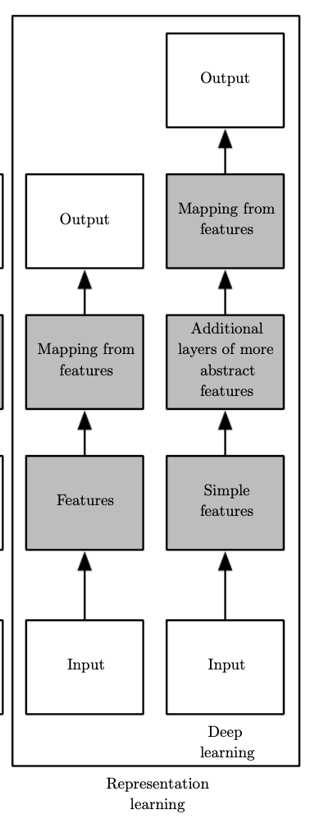
What is DL
Deep learning is essentially a neural network with three or more layers. These neural networks attempt to simulate the behavior of the human brain—albeit far from matching its ability—allowing it to “learn” from large amounts of data.
– IBM
Features are learned automatically

Slide 12
What is AI? The first naïve answer
Artificial intelligence
Intelligence?
Human behaviors (including both smart and stupid)
Artificial
Man-made
Human teach MACHINE to behave intelligence

Slide 13
What is AI? Academic answers
Views of AI fall into four categories:
Thinking humanly Thinking rationally
Acting humanly Acting rationally

Slide 14
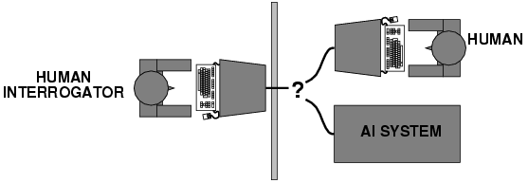
Acting humanly: Turing Test
Turing (1950) "Computing machinery and intelligence":
"Can machines think?" → "Can machines behave intelligently?"
Operational test for intelligent behavior: the Imitation Game

Slide 15
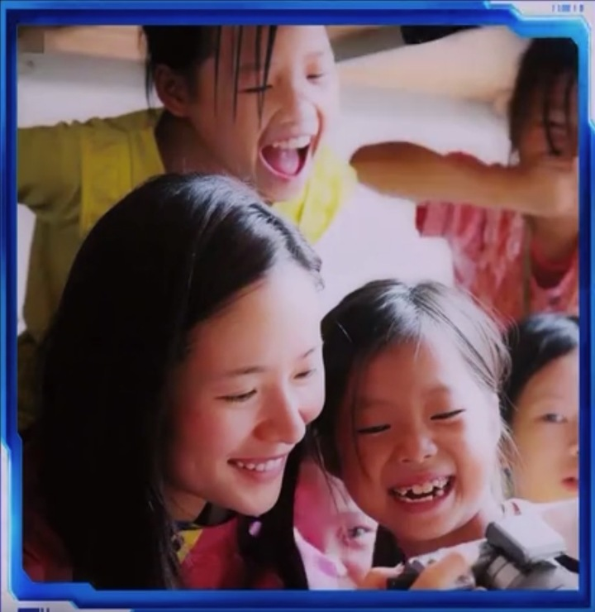
Turing test: poem generated from photo
明星支教照片

Slide 16
which poem is written by computer?
太阳不吝惜光的施予
撒向天空的笑声
和着妙境的音乐
水中清激的灵魂
一如你纯然的美
在这徘徊无助的人间
有了她们就像有了全世界
挥动着透明的羽翼
飞进了梦里的梦
在从容的天空中起舞
繁星闪现
她借他们相机，如赠白马
驮着山里的孩子去远方
现在
要再送他一名天堂的银匠
将没有名字的悲伤
锻造成闪亮的马鞍
那嘹亮笑容里
有对贫瘠生活
精致的反抗
在柔软又带刺的山林里
像只喜鹊一样地活着
后来，我考上了大学
有了第一台爱笑的相机
也有姐姐一样的漂亮牙齿
我抱着相机
给姐姐看铺进村子的铁轨
父母的夕阳婚纱照
和社团里一起爬山的男孩
姐姐笑着凑到我耳边
悄悄讲了个故事

Slide 17
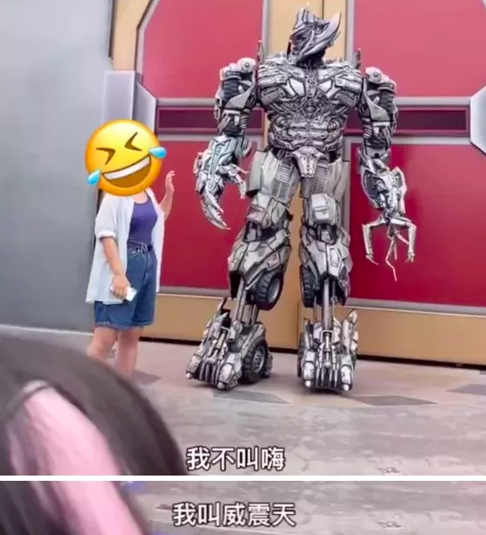
北京环球影城的明星

Slide 18
What is AI? Academic answers
Views of AI fall into four categories:
Thinking humanly Thinking rationally
Acting humanly Acting rationally

Slide 19
Thinking humanly: cognitive modeling
1960s "cognitive revolution": information-processing psychology
Requires scientific theories of internal activities of the brain. How to validate? Requires:
Predicting and testing behavior of human subjects (top-down), or
Direct identification from neurological data (bottom-up)
Both approaches (roughly, Cognitive Science and Cognitive Neuroscience) are now distinct from AI

Slide 20
What is AI? Academic answers
Views of AI fall into four categories:
Thinking humanly Thinking rationally
Acting humanly Acting rationally

Slide 21
Thinking rationally: "laws of thought"
Aristotle: what are correct arguments/thought processes?
Several Greek schools developed various forms of logic: notation and rules of derivation for thoughts; may or may not have proceeded to the idea of mechanization
Direct line through mathematics and philosophy to modern AI
Problems:
Not all intelligent behavior is mediated by logical deliberation
What is the purpose of thinking? What thoughts should I have?

Slide 22
What is AI? Academic answers
Views of AI fall into four categories:
Thinking humanly Thinking rationally
Acting humanly Acting rationally

Slide 23
Acting rationally: rational agent
Rational behavior: doing the right thing
The right thing: that which is expected to maximize goal achievement, given the available information
Doesn't necessarily involve thinking – e.g., blinking reflex – but thinking should be in the service of rational action

Slide 24
Rational agents
An agent is an entity that perceives and acts
Abstractly, an agent is a function from percept histories to actions:
[f: P* → A]
For any given class of environments and tasks, we seek the agent (or class of agents) with the best performance
Caveat: computational limitations make perfect rationality unachievable
→ design best program for given machine resources

Slide 25
State of the art
Deep Blue defeated the reigning world chess champion Garry Kasparov in 1997
Proved a mathematical conjecture (Robbins conjecture) unsolved for decades
No hands across America (driving autonomously 98% of the time from Pittsburgh to San Diego)
During the 1991 Gulf War, US forces deployed an AI logistics planning and scheduling program that involved up to 50,000 vehicles, cargo, and people
NASA's on-board autonomous planning program controlled the scheduling of operations for a spacecraft
AlphaGO/Zero, AlphaFold

Slide 26
Why is AI hard? Cross disciplines
Philosophy
Can formal rules be used to draw valid conclusions?
How does the mind arise from a physical brain?
Where does knowledge come from?
How does knowledge lead to action?

Slide 27
Why is AI hard? Cross disciplines
Mathematics
What are the formal rules to draw valid conclusions?
What can be computed?
How do we reason with uncertain information?

Slide 28
Why is AI hard? Cross disciplines
Economics
How should we make decisions so as to max payoff?
How should we do this when others may not go along?
How should we do this when the payoff may be far in the future?

Slide 29
Why is AI hard? Cross disciplines
Neuroscience
How do brain process information?

Slide 30
Why is AI hard? Cross disciplines
Psychology
How do humans and animals think and act?

Slide 31
Why is AI hard? Cross disciplines
Computer engineering
How can we build an efficient computer? (machine behaves like brain)

Slide 32
Why is AI hard? Cross disciplines
Control theory and cybernetics
How can artifacts operate under their own control?

Slide 33
Why is AI hard? Cross disciplines
Linguistics
How does language relate to thought?

Slide 34
Now AI basically based on:
Computers
But not limited to computers
We need more “machines” involved
Observe (more input)
Decide (more inference)
Control (more output)

Slide 35
Homework 6
Inspired by YOUR REAL LIFE, design an AI product.
Describe the AI attributes of your product
Suppose you have developed your product, how to prove your AI product acting smartly like or better a human. Describe in details your validation solution.

